Slide 1

[Aggregate Anseong Site] Electric Shock RCA Report
- Table of Contents -
Ⅰ. RCA Participants
Ⅱ. Accident Summary
Ⅲ. Root Cause Analysis (RCA)
Ⅳ. Recurrence Prevention Measures
2024.10.02
Anseong Site

Slide 2
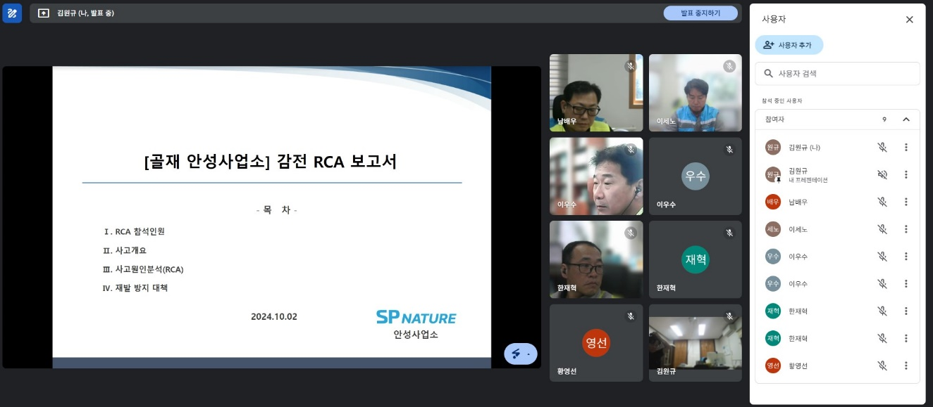
Ⅰ. RCA Attendees
RCA (Root Cause Analysis)
No | Name | Company / Department | Position
1 | Ko Chang-soo | SP Nature / Environmental Safety | CSO
2 | Yoo Min-cheol | SP Nature / Construction Materials Safety Part | Safety Part
3 | Kim Ho-gyeom | SP Nature Co., Ltd. / Construction Materials Safety Part | Safety Part
4 | Kim Jun-hui | SP Nature Co., Ltd. / Anseong Site | Production Team Leader
5 | Kim Won-gyu | SP Nature Co., Ltd. / Anseong Site | Safety Officer
6 | Lee Se-no | SP Nature Co., Ltd. / Yesan Site | Plant Manager
7 | Lee Wu-su | SP Nature Co., Ltd. / Yesan Site | Safety Officer
8 | Jae-hyeok Han | SP Nature Co., Ltd. / Yesan Office | Production Team Leader
No. | Name | Company / Affiliation | Position
9 | Bae-u Nam | Hongmyeong Industry Co., Ltd. | Office Manager
10 | Young-sun Hwang | Hongmyeong Industry Co., Ltd. | Safety Officer
11
12
13
14
15
16
Meeting Photo

Slide 3
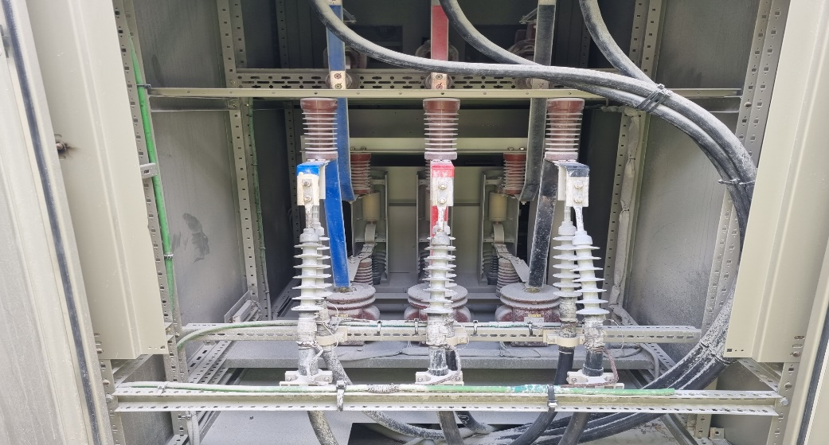
II. Accident Summary
RCA (Root Cause Analysis)
Aggregate Anseong Site Electric Shock Accident
Accident Status
1. Date and Time / Location | Sept. 27 (Fri), 2024, approx. 10:45 AM / Panel Room
2. Injured Person/Affiliation | Manager Eun-taek Kim / Anseong Plant Production Team | 3. Gender/Age | Male / Age 30
4. Accident Type | Electric Shock | 5. Extent of Injury | Burn (Undergoing hospital treatment)
□ Accident Summary - on Friday, Sep 27, 2024, at approx. 10:45 AM, Manager Kim Eun-taek of the Anseong Site Production Team was checking whether corrective actions for findings from the August facility inspection (VCB panel dust accumulation) had been taken, and while opening the panel to remove the dust by blowing on it, an Electric Shock accident occurred ※ currently hospitalized at Yeongdeungpo Hangang Sacred Heart Hospital after burn treatment at Osong Bestian Hospital □ Accident Causes - non-compliance with substation access procedures (insufficient control by safety officer) - LOTOTO not performed (power not disconnected) / shared key management (Production Team) - safety work permit not prepared / two-person rule not followed for inspection - insulating PPE not worn □ Recurrence Prevention Measures - strengthening substation access procedures (single key management / access log) - implementation of LOTOTO (power disconnection, control box: ASS Controller) - preparing safety work permits / implementation of two-person rule for inspections - wearing insulating PPE
Accident Diagram (Photo)

